Slide 1
Garbage Collection and Memory Leak Avoidance in .NET

Slide 2








shapovalov.yuriy
@YuriyShapovalov
shapovalov.yuri@gmail.com
Yurii_Shapovalov@epam.com
linkedin.com/in/yuriyshapovalov
github.com/yuriyshapovalov
codeplex.com/yuriyshapovalov
Yuriy Shapovalov
Senior Software Engineer, EPAM (Kharkov)

Slide 3
CHAPTER 1
Garbage Collection in .NET
CHAPTER 2
AGENDA
How memory leaks affect enterprise applications.
CHAPTER 3
Memory Leak root causes.
CHAPTER 4
Memory profiling and memory leak detection tools.

Slide 4
CHAPTER 1
Garbage Collection in .NET
CHAPTER 2
How memory leaks affect enterprise applications.
CHAPTER 3
Memory Leak root causes.
CHAPTER 4
Memory profiling and memory leak detection tools.

Slide 5

TRACING GC ALGORITHM
Garbage collection algorithm in .NET is based on “Tracing” algorithm which was developed for Lisp language by John McCarthy in 1960.
Also known as “Mark and Sweep”
John McCarthy
an American computer scientist and cognitive scientist

Slide 6

₁Stop all processes, run garbage collector;
₂Trace forward from the roots;
₃Everything touched is alive, anything else is garbage.

Slide 7
TRACING GC ALGORITHM
Every application has a
set of roots:
static variables;
CPU registers;
active local variables and stack roots.
Application Roots
STATIC
STACK
CPU REGISTERS
Managed
Heap

Slide 8
TRACING GC ALGORITHM
Heaps might be:
Managed (.NET heap);
Unmanaged (native for OS).
Managed
Heap
Unmanaged
Heap

Slide 9
TRACING GC ALGORITHM
Application Roots
STATIC
STACK
CPU REGISTERS
Managed
Heap
Unmanaged
Heap

Slide 10
TRACING GC ALGORITHM
Application Roots
STATIC
STACK
CPU REGISTERS
Managed
Heap
Unmanaged
Heap

Slide 11
TRACING GC ALGORITHM
Application Roots
STATIC
STACK
CPU REGISTERS
Managed
Heap
Unmanaged
Heap

Slide 12
TRACING GC ALGORITHM
Application Roots
STATIC
STACK
CPU REGISTERS
Managed
Heap
Unmanaged
Heap

Slide 13
TRACING GC ALGORITHM
Application Roots
STATIC
STACK
CPU REGISTERS
Managed
Heap
Unmanaged
Heap

Slide 14
TRACING GC ALGORITHM
Application Roots
STATIC
STACK
CPU REGISTERS
Managed
Heap
Unmanaged
Heap

Slide 15
₁Younger objects dies faster;
₂Older objects live longer;
₃Garbage collection works faster for part of the heap, than for whole heap.

Slide 16
GLR has 3 generations:
0 – for new objects;
1 – for old objects;
2 – for the oldest.

Slide 17
GENERATIONS
A
B
C
D
E
0
A
B
C
D
E
0
A
B
D
1
0

Slide 18
GENERATIONS
A
B
D
F
G
H
I
J
K
1
0
A
B
D
F
G
H
I
J
K
1
0
A
D
G
H
J
2
1
0

Slide 19
Finalization
GC can be called in following cases
Generation 0 is full
Explicit call static method GC.Collect()
Although Microsoft does not recommend to do that, sometime it make sense to force collecting.
Unload application domain.
CLR treat that application has no roots anymore.
Closing CLR
CLR tries to call Finalize() for each object in managed heap

Slide 20
Finalization
Application Roots
STATIC
STACK
CPU REGISTERS
Managed
Heap
Unmanaged
Heap

Slide 21
Finalization
roots
static
active variables
CPU registers
Managed Heap
d
a
b
c
e
Native Heap

Slide 22
Finalization
roots
a
static
active variables
CPU registers
b
c
Managed Heap
a
b
c
Native Heap
Finalization queue
F-reachable queue

Slide 23
Finalization
roots
a
static
active variables
CPU registers
b
c
Managed Heap
a
b
c
Native Heap
Finalization queue
F-reachable queue

Slide 24
Finalization
roots
a
static
active variables
CPU registers
Managed Heap
b
c
a
b
c
Native Heap
Finalization queue
F-reachable queue

Slide 25
Finalization
roots
a
static
active variables
CPU registers
Managed Heap
c
a
c
Native Heap
Finalization queue
F-reachable queue

Slide 26
Finalization
roots
a
static
active variables
CPU registers
Managed Heap
a
Native Heap
Finalization queue
F-reachable queue

Slide 27
Problems in highly available systems
Memory leak consume available memory space on the server.
It might take one hour or a month.
Sometimes there is only one way to live with this problem – scheduled regular server reboot.
MEMORY
MEMORY
Application
Available
Memory
Application Available Memory

Slide 28
Problems in highly available systems
Memory leak consume available memory space on the server.
It might take one hour or a month.
Sometimes there is only one way to live with this problem – scheduled regular server reboot.
MEMORY
Application
Available
Memory

Slide 29
Performance decrease
Physical Memory
Fast Memory.
Virtual Memory
Much slower memory. Using when physical memory is not enough.
Memory
Physical Memory
Virtual Memory
Application Memory

Slide 30
Performance decrease
Physical Memory
Fast Memory.
Virtual Memory
Much slower memory. Using when physical memory is not enough.
Memory
Physical Memory
Virtual Memory
Application Memory

Slide 31
Performance decrease
Garbage Collector know that there are too less memory left, so it increase garbage collection procedure up to 50 times.
But it does not help, because leaked memory objects are not reachable for GC.
Memory
Physical Memory
Virtual Memory
Application Memory

Slide 32
Memory Leak Types
Memory leak in managed heap
Unintended reference keeping managed object alive
Aggregating object references
Delegates (closure context variables)
Memory leak in unmanaged heap
Resource disposing omitting

Slide 33



Slide 34
Memory Leak in Managed Heap
Managed Heap memory leak usually means that GC can reach the leaked object, but treat it not as garbage due to active references.
public static class SomethingFactory
{
private static List<Something> listOfSomethings = new List<Something>();
public static Something CreateSomething()
{
var something = new Something();
listOfSomethings.Add(something);
return something;
}
}

Slide 35


Slide 36
Memory Leak in Managed Heap
Event Handlers might be a source of memory leaks.
If you subscribe to an event on object1 from object2, then do object2.Dispose() and pretend it doesn't exist (and drop out all references from your code), there is an implicit reference in object1's event that will prevent object2 from being garbage collected.
MyType object2 = new MyType();
object1.SomeEvent += object2.myEventHandler;
// Should call this
// object1.SomeEvent -= object2.myEventHandler;
object2.Dispose();

Slide 37


Slide 38
Memory Leak in Managed Heap
Memory leak in managed heap
Unintended reference keeping managed object alive
Aggregating object references
Delegates (closure context variables)
Managed Heap memory leak usually means that GC can reach the leaked object, but treat it not as garbage due to active references.
Memory leak hard to find in tightly coupled applications.

Slide 39
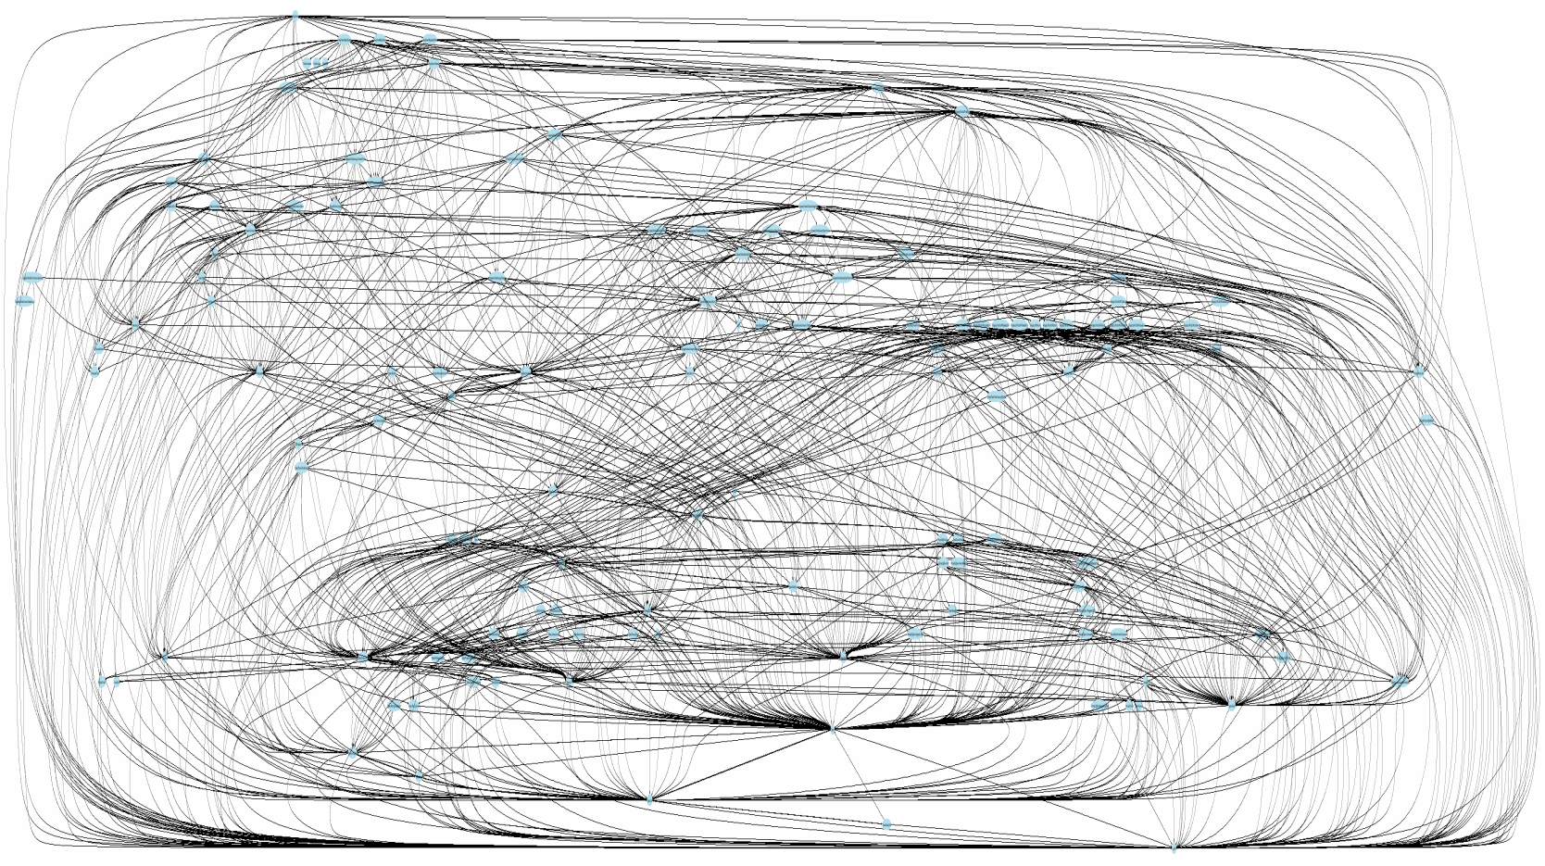
Memory Leak in Managed Heap

Slide 40
Memory Leak in Unmanaged Heap
Memory leak in unmanaged heap
Resource disposing omitting
Managed Heap
Native Heap
Managed Heap
Native Heap

Slide 41
Memory Leak in Unmanaged Heap
Always implement IDisposable interface for classes who using unmanaged resources.
Developer still responsible for correct resource usage.

Slide 42
Profiling Tools
MemProfiler (SciTech Software)
dotTrace Memory (JetBrains)
http://www.jetbrains.com/profiler/
ANTS Performance Profiler 8 (Redgate)
http://www.red-gate.com/products/dotnet-development/ants-performance-profiler/
WinDbg.exe + SOS

Slide 43
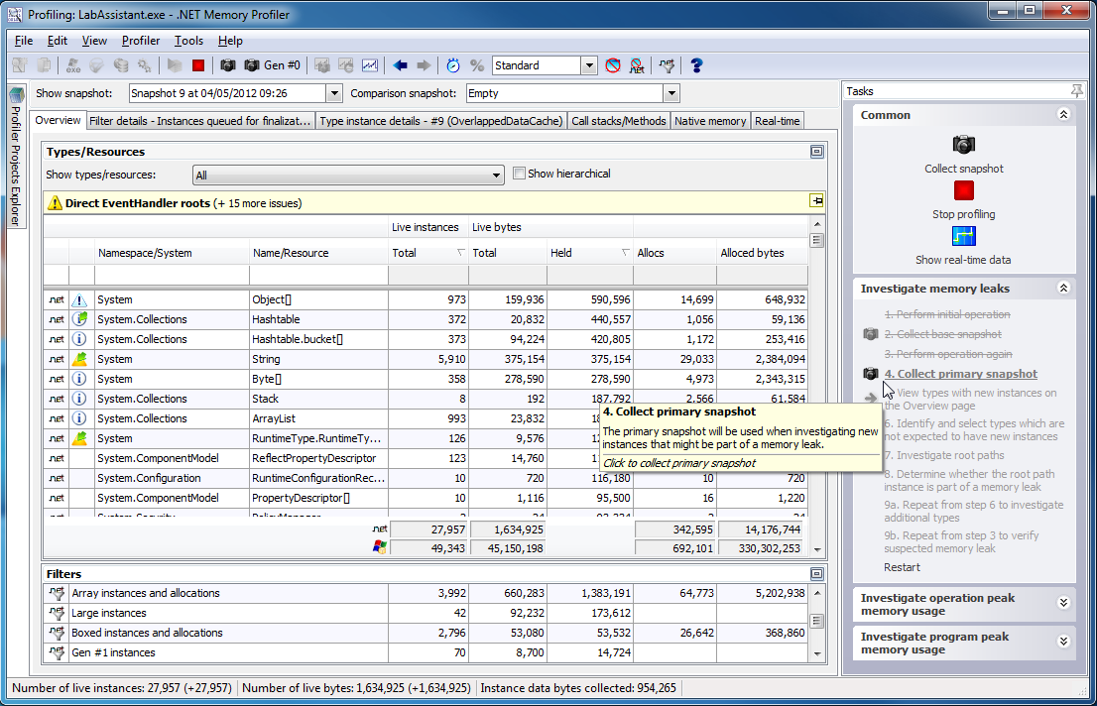
PROFILING TOOL: MEMPROFILER
₁Highly focused on memory profiling and leak detection;
₂Rich User interface;
₃Can work on production server and generate reports.

Slide 44
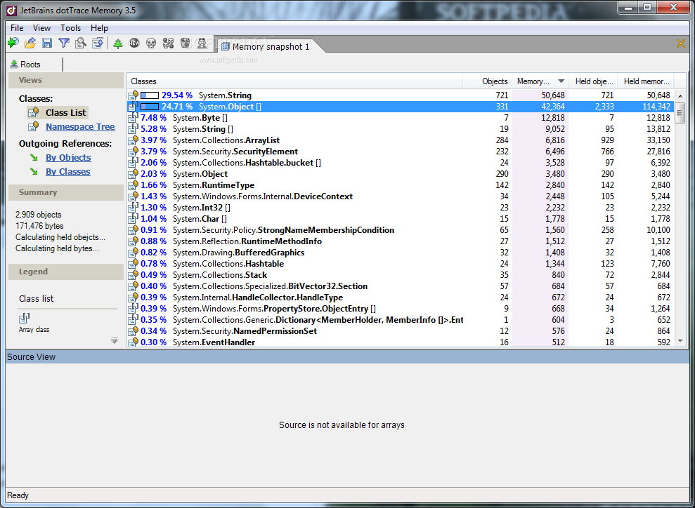
Profiling Tool: dotTrace Memory
Very convenient data representation, easy to use.
Provide referencing to source code which is cause memory leak.

Slide 45
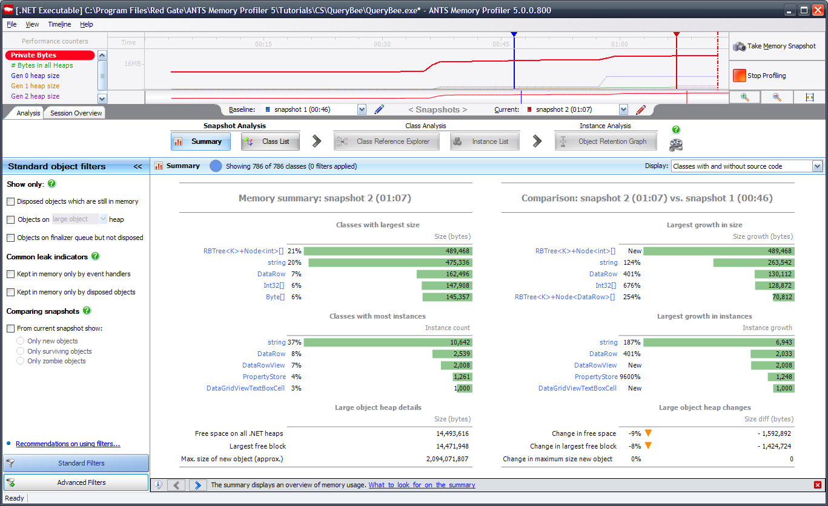
Profiling Tool: ANTS
Many useful features for memory consumption, and performance analysis.
Have data access profiling in latest version.

Slide 46
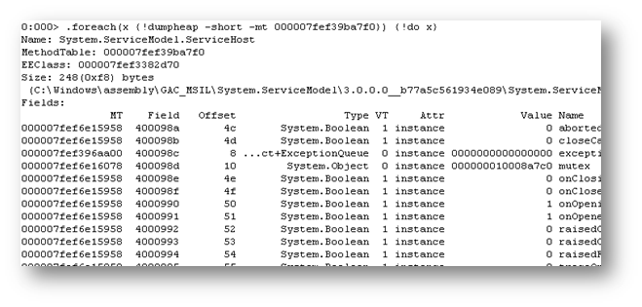
Profiling Tool: Windbg.exe + SOS
Easy and free.
Integrated in Visual Studio
Command based interface.
Good for quick initial memory profiling.

Slide 47
Conclusions
Garbage collector works well, but developers still responsible for correct resource releasing.
Issues with memory leaks might cause performance lacks in production.
Profile memory during development and testing is a good practice.
Might be helpful to choose memory leak detection strategy before deploying application to production.

Slide 48
Q&A

Slide 49
Yuriy Shapovalov
Senior Software Engineer, EPAM (Kharkov)
yurii_shapovalov@epam.com
shapovalov.yuriy
linkedin.com/in/yuriyshapovalov
@YuriyShapovalov

